Slide 1

Introduction to Scripting for image analysis Part 2

Slide 2
Recap of Part 1
Introduced IJ Macro/Scripting Language
Use of FIJI’s Script Editor
Different Types of Variables:
Numerical
Strings
Boolean
Arrays

Slide 3
What do we hope to achieve
Load Image
Split Channels
Save Separate Channels
Build a batch processing template
Load Image
Split Channels
Save Result
Perform Some Task
Customise template for specific task

Slide 4
Flow Control
It is often desirable to control when statements are executed
Sometimes, statements should be skipped altogether
Other times, the same statement should be executed repeatedly
Can be subdivided into conditional statements and loop statements
Conditional Statements:
IF
ELSE
ELSE IF
Looping Statements:
FOR
WHILE
DO WHILE

Slide 5
6 – Loop statements

Slide 6
Looping Statements
FOR:
runs a block of code a specified number of times
WHILE:
repeatedly runs a block of code while a condition is true
DO WHILE:
runs a block of code once then repeats while a condition is true

Slide 7
FOR statements
for (initialise; condition; operation) {
do this;
}
Indentation inside conditional statements & loops is considered good practice
Statements must be enclose by curly braces
FOR statements consist of four components:
Initialise: initialise a variable – typically this variable is used in the loop
Condition: continue executing the loop while this statement is true
Operate: perform some operation at the end of each loop
Print numbers from 0 to 9:
for (count = 0; count < 10; count = count + 1) {
print(count);
}
i = 0;
for ( ; i < 10; ) {
print(i);
i = i + 1;
}

Slide 8
Increment operator
++
for (count = 0; count < 10; count = count + 1) {
print(count);
}
for (count = 0; count < 10; count++) {
print(count);
}

Slide 9
WHILE statements
while(this statement is true){
do this;
}
Essentially a simplified FOR statement
Print numbers from 0 to 9:
i = 0;
while (i < 10) {
print(i);
i++;
}

Slide 10
DO-WHILE statements
do {
do this;
} while (this statement is true);
Essentially a reversed WHILE statement
Print numbers from 0 to 9:
i = 0;
do {
print(i);
i++;
} while (i < 10);

Slide 11
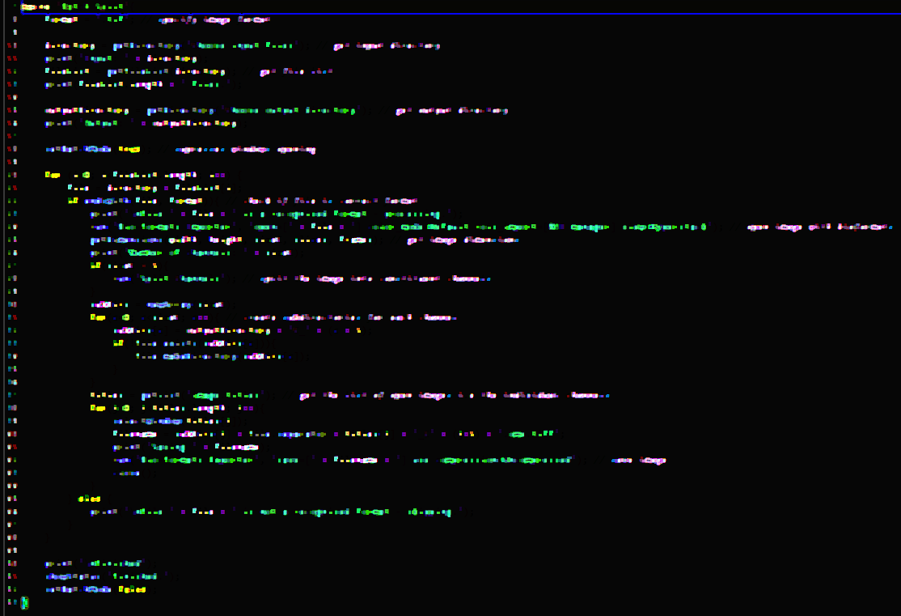
DEMO 8 – Loop Statements
Open Snippets/08_Loop_Statements.ijm
width

Slide 12
Problem 2 – Loop Statements
Open Problems/2_Loops.ijm
width

Slide 13
7 – Conditional statements

Slide 14
Conditional Statements
IF:
runs a block of code if a specified condition is true
ELSE:
combines with IF statement
runs a block of code if the condition specified in the IF statement is not true
ELSE IF:
combines with IF statement
runs a block of code if the condition specified in the IF statement is not true but a second specified condition is true

Slide 15
IF statements
if (this statement is true) {
do this;
}
N = nImages(); // get number of open images
if (N > 0) {
title = getTitle(); // get the title of the active image
print("title: " + title); // print the image title
}
Indentation inside conditional statements & loops is considered good practice

Slide 16
IF-ELSE statements
if (this statement is true) {
do this;
} else {
do this;
}
if (nImages() == 0){
print("No images are open - exiting");
} else {
print("Processing image " + getTitle());
}

Slide 17
IF-ELSE IF statements
if (this statement is true) {
do this;
} else if(this statement is true){
do this;
} else if(this statement is true){
do this;
} else{
do this;
}
if (nImages() == 0){
print("No images are open - exiting");
} else if (nImages() < 4) {
print("Processing image " + getTitle());
} else {
print("Too many images open - aborting!");
}

Slide 18
“Nesting”
Any number of conditional and loop statements can be “nested” within each other
denom = 3;
for(i = 1; i <= 30; i++){
if(i % denom == 0){
divisible = "is";
} else {
divisible = "is not";
} print(i + " " + divisible + " divisible by " + denom);
}
if(this is true){
if(this is true){
if(this is true){
while(this is true){
if(this is true){
for(initialise; condition; increment){
if(this is true){
do this;
} else {
if(this is true){
do this;
}
}
}
} while (this is true){
do this;
}
}
}
} else {
do this;
}
}
However, excessive nesting is considered poor coding practice

Slide 19
DEMO 9 – Conditional Statements
Open Snippets/09_Conditional_Statements.ijm
width

Slide 20
Problem 3 – Conditional Statements
Open Problems/3_Conditional_Statements.ijm
width

Slide 21
5 – Using Built-In Functions

Slide 22
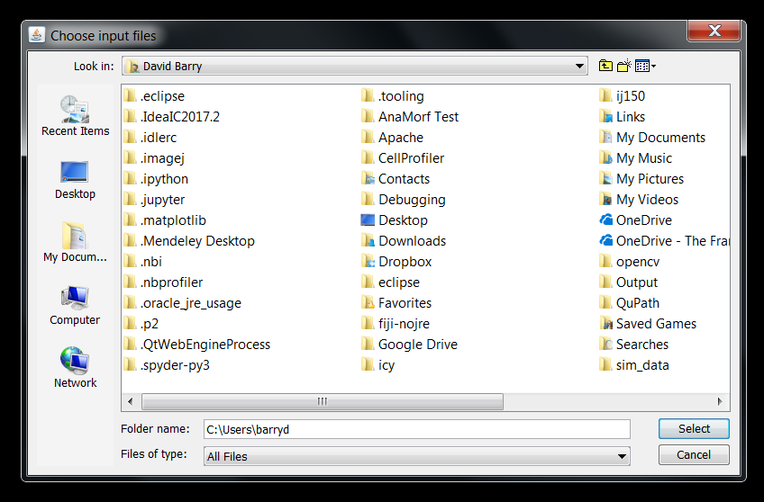
The Get Directory function
getDirectory(string)
Displays a “choose directory” dialog and returns the selected directory.
Returns an “empty” string if the specified directory is not found.

Slide 23
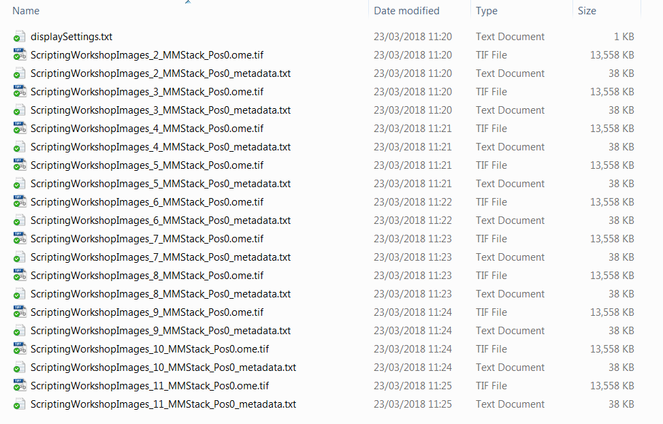
The Get File List function
getFileList(directory)
Returns a list of the file names in the specified directory

Slide 24
The ENDS WITH function
endsWith(string, suffix)
Returns true if string ends with suffix, otherwise returns false;
endsWith(file, format)
Check whether the variable file ends with specified suffix
In other words, check if the file is of the specified file format
Processing the wrong file type will likely produce an error
Good example of error checking – never assume the user knows what they are doing!

Slide 25
9 – Manipulating files

Slide 26
File Functions
Get information about a file
Read or write a text file
Create a directory
Delete, rename or move a file or directory.
File.exists(path)
Returns true if the specified file exists.
File.makeDirectory(path)
Creates a directory.
File.separator
Returns the file name separator character ("/" or "\").

Slide 27
DEMO 11 – File Functions
Open Snippets/11_File_Functions.ijm
width

Slide 28
10 – Manipulating images

Slide 29
Let’s do something with images!
We have a script that will open images and create directories
Now we need to do something with the images
Q: How do we direct FIJI to a particular image?
A: We need to know the image names
getList("image.titles")
Returns a list (array) of image window titles.
getList("window.titles")
Returns a list (array) of non-image window titles.

Slide 30
Before doing anything with an image, we need to tell FIJI which image we want to work on…
selectWindow("name")
Activates the window with the title "name".

Slide 31
Close Function
close()
Closes the active image.
close(pattern)
Closes windows whose title matches 'pattern'.
For example, close("Histo*") would close all histogram windows.
Use close("*") to close all image windows.

Slide 32
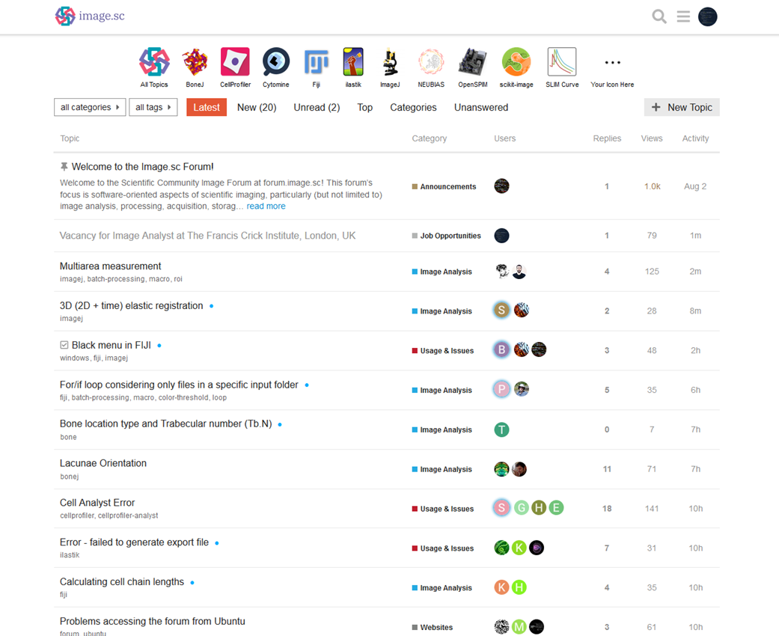

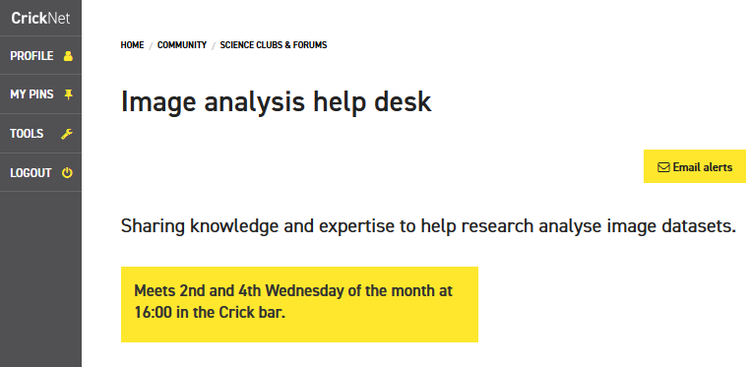


Thanks for sticking around
david.barry@crick.ac.uk
SW302

Slide 33
Useful references
https://doi.org/10.1371/journal.pcbi.1007433
https://doi.org/10.1371/journal.pcbi.1005871

Slide 34
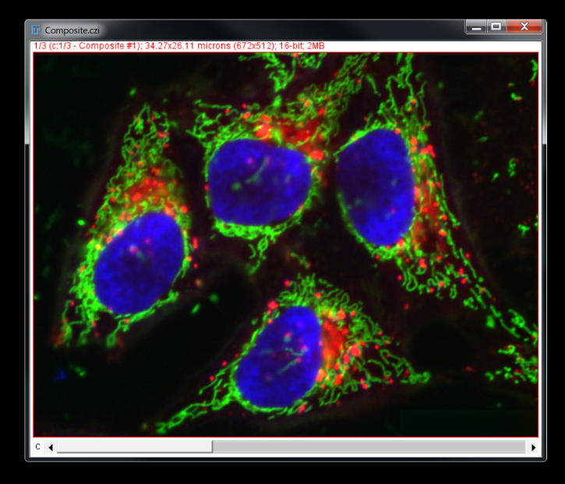
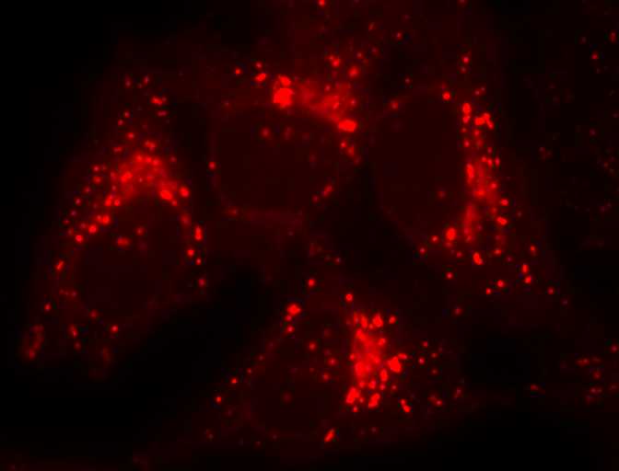
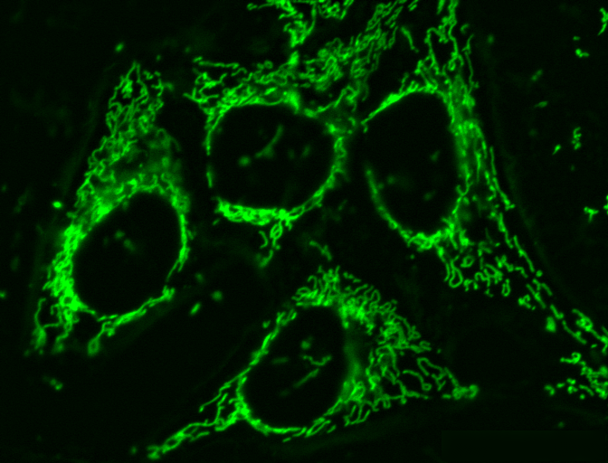
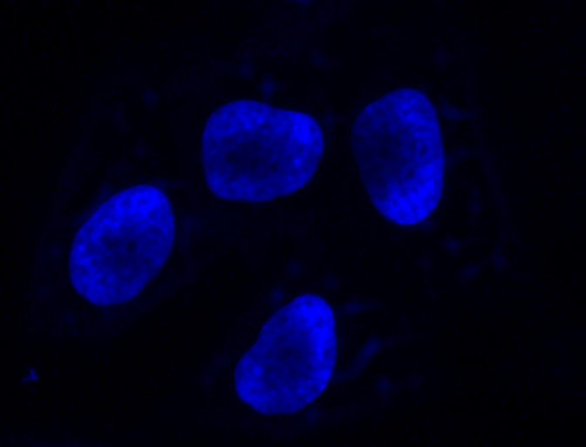
Challenge 1
Split all images into their constituent channels

Slide 35
we begin by defining a variable…
macro "Batch Split"{
format = ".tif";
...
}

Slide 36
macro "Batch Split"{
format = ".tif";
directory = getDirectory("Choose input files");
...
}

Slide 37
macro "Batch Split"{
format = ".tif";
directory = getDirectory("Choose input files");
print("Input: " + directory);
...
}

Slide 38
macro "Batch Split"{
format = ".tif";
directory = getDirectory("Choose input files");
print("Input: " + directory);
fileList = getFileList(directory);
...
}

Slide 39
macro "Batch Split"{
format = ".tif";
directory = getDirectory("Choose input files");
print("Input: " + directory);
fileList = getFileList(directory);
print(fileList.length + " files.");
...
}

Slide 40
macro "Batch Split"{
format = ".tif";
directory = getDirectory("Choose input files");
print("Input: " + directory);
fileList = getFileList(directory);
print(fileList.length + " files.");
outputDirectory = getDirectory("Choose output directory");
print("Output: " + outputDirectory);
setBatchMode(true);
...
}

Slide 41
The Set Batch Mode function
setBatchMode(arg)
Controls whether images are visible or hidden during macro execution.
Why is this useful?
Interacting with a window mid-macro can cause errors
Batch mode macros run up to 20x faster.
Load pixel data
Create canvas to display image
Create window to display canvas
Display window, monitor user input

Slide 42
DEMO 7 – Batch Mode
Open Snippets/07_Batch_Mode.ijm
width

Slide 43
macro "Batch Split"{
format = ".tif";
directory = getDirectory("Choose input files");
print("Input: " + directory);
fileList = getFileList(directory)
print(fileList.length + " files.");
outputDirectory = getDirectory("Choose output directory");
print("Output: " + outputDirectory);
setBatchMode(true);
...
setBatchMode(false);
}
Now we want to do something useful with the image files

Slide 44
macro "Batch Split"{
format = ".tif";
directory = getDirectory("Choose input files");
print("Input: " + directory);
fileList = getFileList(directory)
print(fileList.length + " files.");
outputDirectory = getDirectory("Choose output directory");
print("Output: " + outputDirectory);
setBatchMode(true);
for (i = 0; i < fileList.length; i++) {
...
}
setBatchMode(false);
}

Slide 45
macro "Batch Split"{
format = ".tif";
directory = getDirectory("Choose input files");
print("Input: " + directory);
fileList = getFileList(directory)
print(fileList.length + " files.");
outputDirectory = getDirectory("Choose output directory");
print("Output: " + outputDirectory);
setBatchMode(true);
for (i = 0; i < fileList.length; i++) {
file = directory + fileList[i];
...
}
setBatchMode(false);
}
We could now, for example, list all the file names

Slide 46
macro "Batch Split"{
format = ".tif";
directory = getDirectory("Choose input files");
print("Input: " + directory);
fileList = getFileList(directory)
print(fileList.length + " files.");
outputDirectory = getDirectory("Choose output directory");
print("Output: " + outputDirectory);
setBatchMode(true);
for (i = 0; i < fileList.length; i++) {
file = directory + fileList[i];
print("Current File: " + file);
...
}
setBatchMode(false);
}
However, it would be useful to check what the file is first…

Slide 47
macro "Batch Split"{
format = ".tif";
directory = getDirectory("Choose input files");
print("Input: " + directory);
fileList = getFileList(directory)
print(fileList.length + " files.");
outputDirectory = getDirectory("Choose output directory");
print("Output: " + outputDirectory);
setBatchMode(true);
for (i = 0; i < fileList.length; i++) {
file = directory + fileList[i];
if(endsWith(file, format)){
...
}
...
}
setBatchMode(false);
}

Slide 48
macro "Batch Split"{
format = ".tif";
directory = getDirectory("Choose input files");
print("Input: " + directory);
fileList = getFileList(directory)
print(fileList.length + " files.");
outputDirectory = getDirectory("Choose output directory");
print("Output: " + outputDirectory);
setBatchMode(true);
for (i = 0; i < fileList.length; i++) {
file = directory + fileList[i];
if(endsWith(file, format)){
...
}
...
}
setBatchMode(false);
}

Slide 49
macro "Batch Split"{
format = ".tif";
directory = getDirectory("Choose input files");
print("Input: " + directory);
fileList = getFileList(directory)
print(fileList.length + " files.");
outputDirectory = getDirectory("Choose output directory");
print("Output: " + outputDirectory);
setBatchMode(true);
for (i = 0; i < fileList.length; i++) {
file = directory + fileList[i];
if(endsWith(file, format)){
print("\nFile " + file + " is a recognised format - processing.");
}
...
}
setBatchMode(false);
}

Slide 50
macro "Batch Split"{
format = ".tif";
directory = getDirectory("Choose input files");
print("Input: " + directory);
fileList = getFileList(directory)
print(fileList.length + " files.");
outputDirectory = getDirectory("Choose output directory");
print("Output: " + outputDirectory);
setBatchMode(true);
for (i = 0; i < fileList.length; i++) {
file = directory + fileList[i];
if(endsWith(file, format)){
print("\nFile " + file + " is a recognised format - processing.");
} else {
print("\nFile " + file + " is not a recognised format - skipping.");
}
}
setBatchMode(false);
}
I’m running out of space, so I’m just going to focus on the content of the ‘for’ loop now…
So let’s do something with these files…

